Slide 1
Tạo Thủ Tục
(Procedures)
Notes:
Schedule: Timing Topic
30 minutes Lecture
30 minutes Total

Slide 2
Nội dung
  Cấu trúc khối lệnh PL/SQL.
  Khái niệm Subprogram
  Cấu trúc của Procedure.
    Tạo Procedure
    Thực thi một procedure
    Kiểm soát ngoại lệ trong procedure
    Xóa một procedure

Slide 3
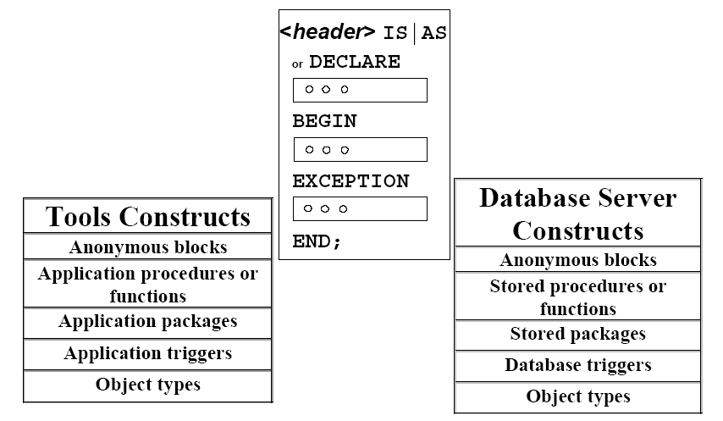
Cấu trúc khối lệnh PL/SQL

Slide 4
Cấu trúc khối lệnh PL/SQL : Các kiểu khối lệnh
Anonymous Procedure Function
[DECLARE]
BEGIN
--statements
[EXCEPTION]
END;
PROCEDURE name
IS
BEGIN
--statements
[EXCEPTION]
END;
FUNCTION name
RETURN datatype
IS
BEGIN
--statements
RETURN value;
[EXCEPTION]
END;
- Mỗi đơn vị của PL/SQL có 1 hay nhiều block
- Một block có thể là một khối không tên hoặc sub-program
Notes:
Block Types
Every unit of PL/SQL comprises one or more blocks. These blocks can be entirely separate or nested one within another. The basic units (procedures and functions, also known as subprograms, and anonymous blocks) that make up a PL/SQL program are logical blocks, which can contain any number of nested subblocks. Therefore, one block can represent a small part of another block, which in turn can be part of the whole unit of code. Of the two types of PL/SQL constructs available, anonymous blocks and subprograms, only anonymous blocks are covered in this course.
Anonymous Blocks
Anonymous blocks are unnamed blocks. They are declared at the point in an application where they are to be executed and are passed to the PL/SQL engine for execution at runtime. You can embed an anonymous block within a precompiler program and within SQL*Plus or Server Manager. Triggers in Oracle Developer components consist of such blocks.
Subprograms
Subprograms are named PL/SQL blocks that can take parameters and can be invoked. You can declare them either as procedures or as functions. Generally you use a procedure to perform an action and a function to compute a value.
You can store subprograms at the server or application level. Using Oracle Developer components (Forms, Reports, and Graphics), you can declare procedures and functions as part of the application (a form or report) and call them from other procedures, functions, and triggers (see next page) within the same application whenever necessary.
Note: A function is similar to a procedure, except that a function must return a value. Procedures and functions are covered in the next PL/SQL course.

Slide 5
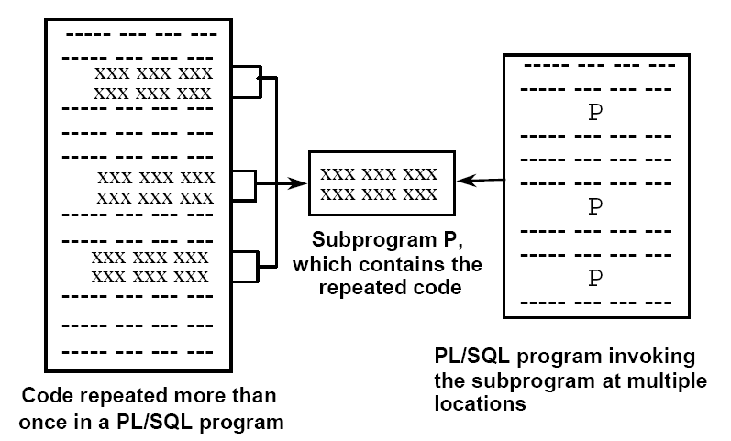
Tổng quát về Subprogram

Slide 6
Tổng quát về Subprogram
  Là một PL/SQL block được đặt tên mà có thể chấp nhận các tham số và thực thi trong môi trường được gọi
  Là một trong 2 loại sau:
    Procedure : là thủ tục thực hiện một hành động
    Function : là hàm để tính toán giá trị
  Là một khối cấu trúc PL/SQL chuẩn
  Cung cấp khả năng module hóa, dùng lại, mở rộng và bảo trì

Slide 7
Procedure
  Là một loại Subprogram để thực hiện một hành động nào đó.
  Procedure được lưu trong database dưới dạng các đối tượng của Schema hay trên các form trong môi trường form builder.

Slide 8
Lợi ích của Procedure
  Dễ dàng bảo trì
  Mã chương trình rõ ràng
  Tối ưu khả năng bảo mật dữ liệu và tính toàn vẹn
  Tối ưu hiệu suất thực thi

Slide 9
Cấu trúc của Procedure
Subprogram Specification
  <header>
  IS | AS
  Declaration section
  BEGIN
  Executable section
  EXCEPTION (optional)
  Exception section
  END;
Subprogram Body

Slide 10
Ví dụ Procedure
CREATE OR REPLACE PROCEDURE leave_emp
(p_id IN employees.employee_id%TYPE)
IS
BEGIN
DELETE FROM employees
WHERE employee_id = p_id;
log_execution;
END leave_emp;

Slide 11
Tạo Procedure trong Database
Cú pháp
  CREATE [OR REPLACE] PROCEDURE procedure_name
  [(argument1 [mode1] datatype1,
  argument2 [mode2] datatype2,
  ...)]
  IS | AS
  BEGIN
  PL/SQL Block;
  END;
- The REPLACE option indicates that if the procedure exists, it will be dropped and replaced with the new version created by the statement.
- PL/SQL block starts with either BEGIN or the declaration of local variables and ends with either END or END procedure_name.
Notes:
About PL/SQL
Procedural Language/SQL (PL/SQL) is Oracle Corporation’s procedural language extension to SQL, the standard data access language for relational databases. PL/SQL offers modern software engineering features such as data encapsulation, exception handling, information hiding, and object orientation, and so brings state-of-the-art programming to the Oracle Server and Toolset.
PL/SQL incorporates many of the advanced features made in programming languages designed during the 1970s and 1980s. It allows the data manipulation and query statements of SQL to be included in block-structured and procedural units of code, making PL/SQL a powerful transaction processing language. With PL/SQL, you can use SQL statements to finesse Oracle data and PL/SQL control statements to process the data.

Slide 12
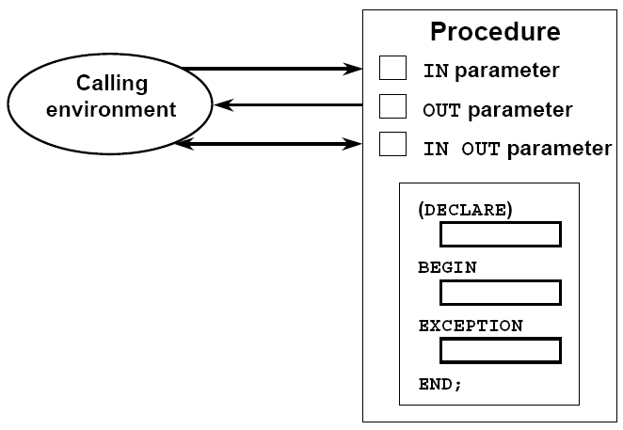
Procedural Parameter Modes

Slide 13
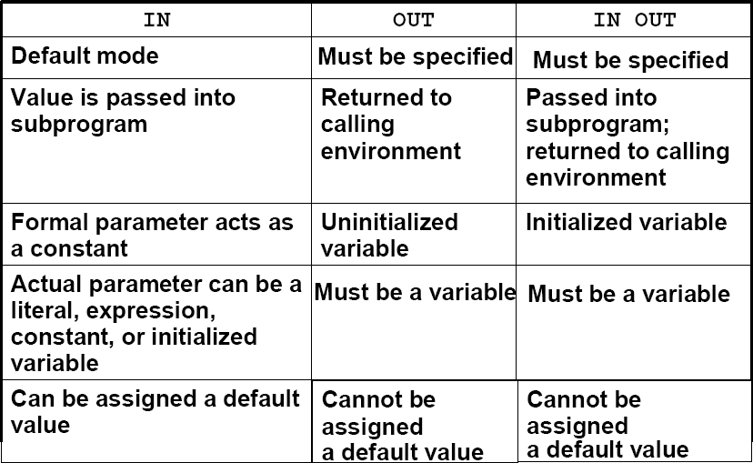
Creating Procedures with Parameters
Notes:
actual

Slide 14

Ví dụ tham số IN
  CREATE OR REPLACE PROCEDURE raise_salary
  (p_id IN employees.employee_id%TYPE)
  IS
  BEGIN
  UPDATE employees
  SET salary = salary * 1.10
  WHERE employee_id = p_id;
  END raise_salary;
  /
  EXECUTE raise_salary(176)
Notes:
About PL/SQL
Procedural Language/SQL (PL/SQL) is Oracle Corporation’s procedural language extension to SQL, the standard data access language for relational databases. PL/SQL offers modern software engineering features such as data encapsulation, exception handling, information hiding, and object orientation, and so brings state-of-the-art programming to the Oracle Server and Toolset.
PL/SQL incorporates many of the advanced features made in programming languages designed during the 1970s and 1980s. It allows the data manipulation and query statements of SQL to be included in block-structured and procedural units of code, making PL/SQL a powerful transaction processing language. With PL/SQL, you can use SQL statements to finesse Oracle data and PL/SQL control statements to process the data.

Slide 15
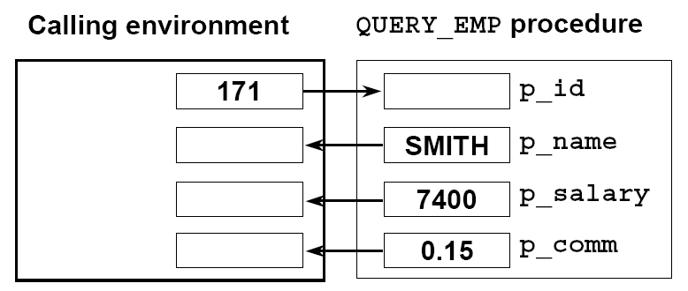
Ví dụ tham số OUT
Notes:
About PL/SQL
Procedural Language/SQL (PL/SQL) is Oracle Corporation’s procedural language extension to SQL, the standard data access language for relational databases. PL/SQL offers modern software engineering features such as data encapsulation, exception handling, information hiding, and object orientation, and so brings state-of-the-art programming to the Oracle Server and Toolset.
PL/SQL incorporates many of the advanced features made in programming languages designed during the 1970s and 1980s. It allows the data manipulation and query statements of SQL to be included in block-structured and procedural units of code, making PL/SQL a powerful transaction processing language. With PL/SQL, you can use SQL statements to finesse Oracle data and PL/SQL control statements to process the data.

Slide 16
Ví dụ tham số OUT
emp_query.sql
  CREATE OR REPLACE PROCEDURE query_emp
  (p_id IN employees.employee_id%TYPE,
  p_name OUT employees.last_name%TYPE,
  p_salary OUT employees.salary%TYPE,
  p_comm OUT employees.commission_pct%TYPE)
  IS
  BEGIN
  SELECT last_name, salary, commission_pct
  INTO p_name, p_salary, p_comm
  FROM employees
  WHERE employee_id = p_id;
  END query_emp;
  /
Notes:
About PL/SQL
Procedural Language/SQL (PL/SQL) is Oracle Corporation’s procedural language extension to SQL, the standard data access language for relational databases. PL/SQL offers modern software engineering features such as data encapsulation, exception handling, information hiding, and object orientation, and so brings state-of-the-art programming to the Oracle Server and Toolset.
PL/SQL incorporates many of the advanced features made in programming languages designed during the 1970s and 1980s. It allows the data manipulation and query statements of SQL to be included in block-structured and procedural units of code, making PL/SQL a powerful transaction processing language. With PL/SQL, you can use SQL statements to finesse Oracle data and PL/SQL control statements to process the data.

Slide 17

Các tham số IN OUT
Calling environment thủ tục FORMAT_PHONE
  CREATE OR REPLACE PROCEDURE format_phone
  (p_phone_no IN OUT VARCHAR2)
  IS
  BEGIN
  p_phone_no := '(' || SUBSTR(p_phone_no,1,3) ||
  ')' || SUBSTR(p_phone_no,4,3) ||
  '-' || SUBSTR(p_phone_no,7);
  END format_phone;
  /
Notes:
About PL/SQL
Procedural Language/SQL (PL/SQL) is Oracle Corporation’s procedural language extension to SQL, the standard data access language for relational databases. PL/SQL offers modern software engineering features such as data encapsulation, exception handling, information hiding, and object orientation, and so brings state-of-the-art programming to the Oracle Server and Toolset.
PL/SQL incorporates many of the advanced features made in programming languages designed during the 1970s and 1980s. It allows the data manipulation and query statements of SQL to be included in block-structured and procedural units of code, making PL/SQL a powerful transaction processing language. With PL/SQL, you can use SQL statements to finesse Oracle data and PL/SQL control statements to process the data.

Slide 18
Khai báo subprogram trong Procedure
leave_emp2.sql
  CREATE OR REPLACE PROCEDURE leave_emp2
  (p_id IN employees.employee_id%TYPE)
  IS
  PROCEDURE log_exec
  IS
  BEGIN
  INSERT INTO log_table (user_id, log_date)
  VALUES (USER, SYSDATE);
  END log_exec;
  BEGIN
  DELETE FROM employees
  WHERE employee_id = p_id;
  log_exec;
  END leave_emp2;
  /
Notes:
About PL/SQL
Procedural Language/SQL (PL/SQL) is Oracle Corporation’s procedural language extension to SQL, the standard data access language for relational databases. PL/SQL offers modern software engineering features such as data encapsulation, exception handling, information hiding, and object orientation, and so brings state-of-the-art programming to the Oracle Server and Toolset.
PL/SQL incorporates many of the advanced features made in programming languages designed during the 1970s and 1980s. It allows the data manipulation and query statements of SQL to be included in block-structured and procedural units of code, making PL/SQL a powerful transaction processing language. With PL/SQL, you can use SQL statements to finesse Oracle data and PL/SQL control statements to process the data.

Slide 19
Chạy Procerdure từ một PL/SQL Anonymous
  DECLARE
  v_id NUMBER := 163;
  BEGIN
  raise_salary(v_id); --invoke procedure
  COMMIT;
  ...
  END;
Notes:
About PL/SQL
Procedural Language/SQL (PL/SQL) is Oracle Corporation’s procedural language extension to SQL, the standard data access language for relational databases. PL/SQL offers modern software engineering features such as data encapsulation, exception handling, information hiding, and object orientation, and so brings state-of-the-art programming to the Oracle Server and Toolset.
PL/SQL incorporates many of the advanced features made in programming languages designed during the 1970s and 1980s. It allows the data manipulation and query statements of SQL to be included in block-structured and procedural units of code, making PL/SQL a powerful transaction processing language. With PL/SQL, you can use SQL statements to finesse Oracle data and PL/SQL control statements to process the data.

Slide 20
Chạy Procedure từ Procedure khác
Process_emps.sql
  CREATE OR REPLACE PROCEDURE process_emps
  IS
  CURSOR emp_cursor IS
  SELECT employee_id
  FROM employees;
  BEGIN
  FOR emp_rec IN emp_cursor
  LOOP
  raise_salary(emp_rec.employee_id);
  END LOOP;
  COMMIT;
  END process_emps;
  /
Notes:
About PL/SQL
Procedural Language/SQL (PL/SQL) is Oracle Corporation’s procedural language extension to SQL, the standard data access language for relational databases. PL/SQL offers modern software engineering features such as data encapsulation, exception handling, information hiding, and object orientation, and so brings state-of-the-art programming to the Oracle Server and Toolset.
PL/SQL incorporates many of the advanced features made in programming languages designed during the 1970s and 1980s. It allows the data manipulation and query statements of SQL to be included in block-structured and procedural units of code, making PL/SQL a powerful transaction processing language. With PL/SQL, you can use SQL statements to finesse Oracle data and PL/SQL control statements to process the data.

Slide 21
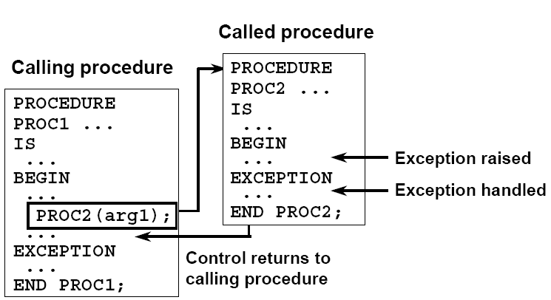
Những ngoại lệ điều khiển được
Notes:
Summary
PL/SQL is a language that has programming features that serve as an extension to SQL. It provides control-of-flow constructs and lets you declare and use variables. PL/SQL applications can run on any platform and operating system on which Oracle runs.

Slide 22
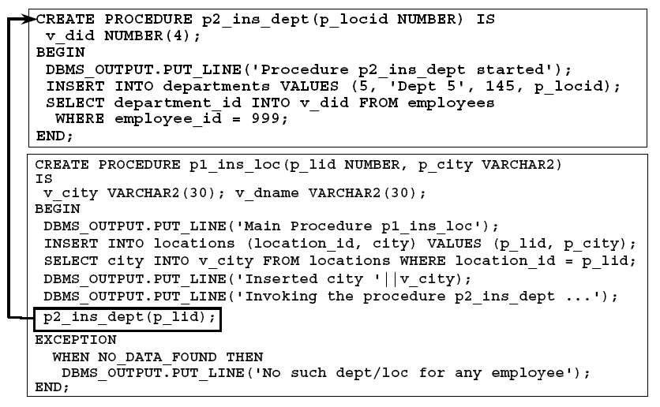
Những ngoại lệ điều khiển được
Notes:
Summary
PL/SQL is a language that has programming features that serve as an extension to SQL. It provides control-of-flow constructs and lets you declare and use variables. PL/SQL applications can run on any platform and operating system on which Oracle runs.

Slide 23
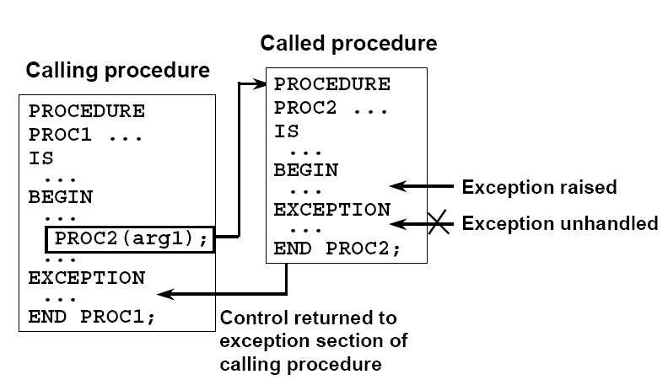
Những ngoại lệ không điều khiển được
Notes:
Summary
PL/SQL is a language that has programming features that serve as an extension to SQL. It provides control-of-flow constructs and lets you declare and use variables. PL/SQL applications can run on any platform and operating system on which Oracle runs.

Slide 24
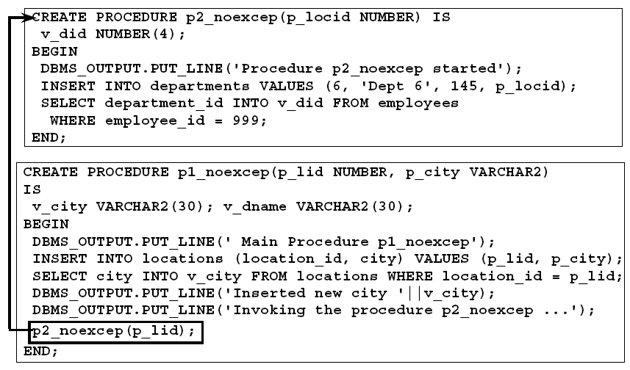
Những ngoại lệ không điều khiển được
Notes:
Summary
PL/SQL is a language that has programming features that serve as an extension to SQL. It provides control-of-flow constructs and lets you declare and use variables. PL/SQL applications can run on any platform and operating system on which Oracle runs.

Slide 25
Xóa một Procedure
Xóa thủ tục lưu trong database
Cú pháp
  DROP PROCEDURE procedure_name
Ví dụ
  DROP PROCEDURE raise_salary;
Notes:
About PL/SQL
Procedural Language/SQL (PL/SQL) is Oracle Corporation’s procedural language extension to SQL, the standard data access language for relational databases. PL/SQL offers modern software engineering features such as data encapsulation, exception handling, information hiding, and object orientation, and so brings state-of-the-art programming to the Oracle Server and Toolset.
PL/SQL incorporates many of the advanced features made in programming languages designed during the 1970s and 1980s. It allows the data manipulation and query statements of SQL to be included in block-structured and procedural units of code, making PL/SQL a powerful transaction processing language. With PL/SQL, you can use SQL statements to finesse Oracle data and PL/SQL control statements to process the data.

Slide 26
Tóm tắt
  Procedure là một chương trình con dùng thực hiện một hành động nào đó.
  Bạn có thể tạo thủ tục bằng lệnh CREATE PROCEDURE
  Bạn có thể biên dịch và lưu thủ tục vào trong database
  Các tham số được dùng để nhận dữ liệu vào từ môi trường được gọi
  Có 3 loại tham số: IN, OUT, IN OUT
Notes:
Summary
PL/SQL is a language that has programming features that serve as an extension to SQL. It provides control-of-flow constructs and lets you declare and use variables. PL/SQL applications can run on any platform and operating system on which Oracle runs.

